Slide 1
Second-Hand Car Trade Using Blockchain
By:
Arun Pradeep 195002014
Bhavna Magendiran 195002021
Guided by:
Dr. S. Mohanavalli

Slide 2
OUTLINE
Expected Outcomes
Project Timeline
System Design
Implementation with results
Cost (Techstack used)
Future work

Slide 3
EXPECTED OUTCOMES
PHASE 1 | Planning Phase | Requirements of the project, identifying business problem
PHASE 2 | Design Phase | Blockchain architecture, other technical details
PHASE 3 | Development Phase | development of application (Front-end, Back-end separately)
PHASE 4 | Deployment Phase | Integration of Front-end and Back-end Deployment of application
PHASE 5 | Production Phase | Testing, Deploying application
Notes:
A

Slide 4
PROJECT TIMELINE
 | WEEK 1 | WEEK 2 | WEEK 3 | WEEK 4 | WEEK 5 | WEEK 6 | WEEK 7 | WEEK 8
Proof of concept | 26th Feb - 4th Mar
Develop |  | 5th Mar - 1st Apr
Integrate |  |  |  |  | 26th Mar - 8th Apr
Test |  |  |  |  |  |  | 9nd Apr - 15th Apr
Deploy |  |  |  |  |  |  |  | 15th Apr - 22th Apr
Notes:
B

Slide 5
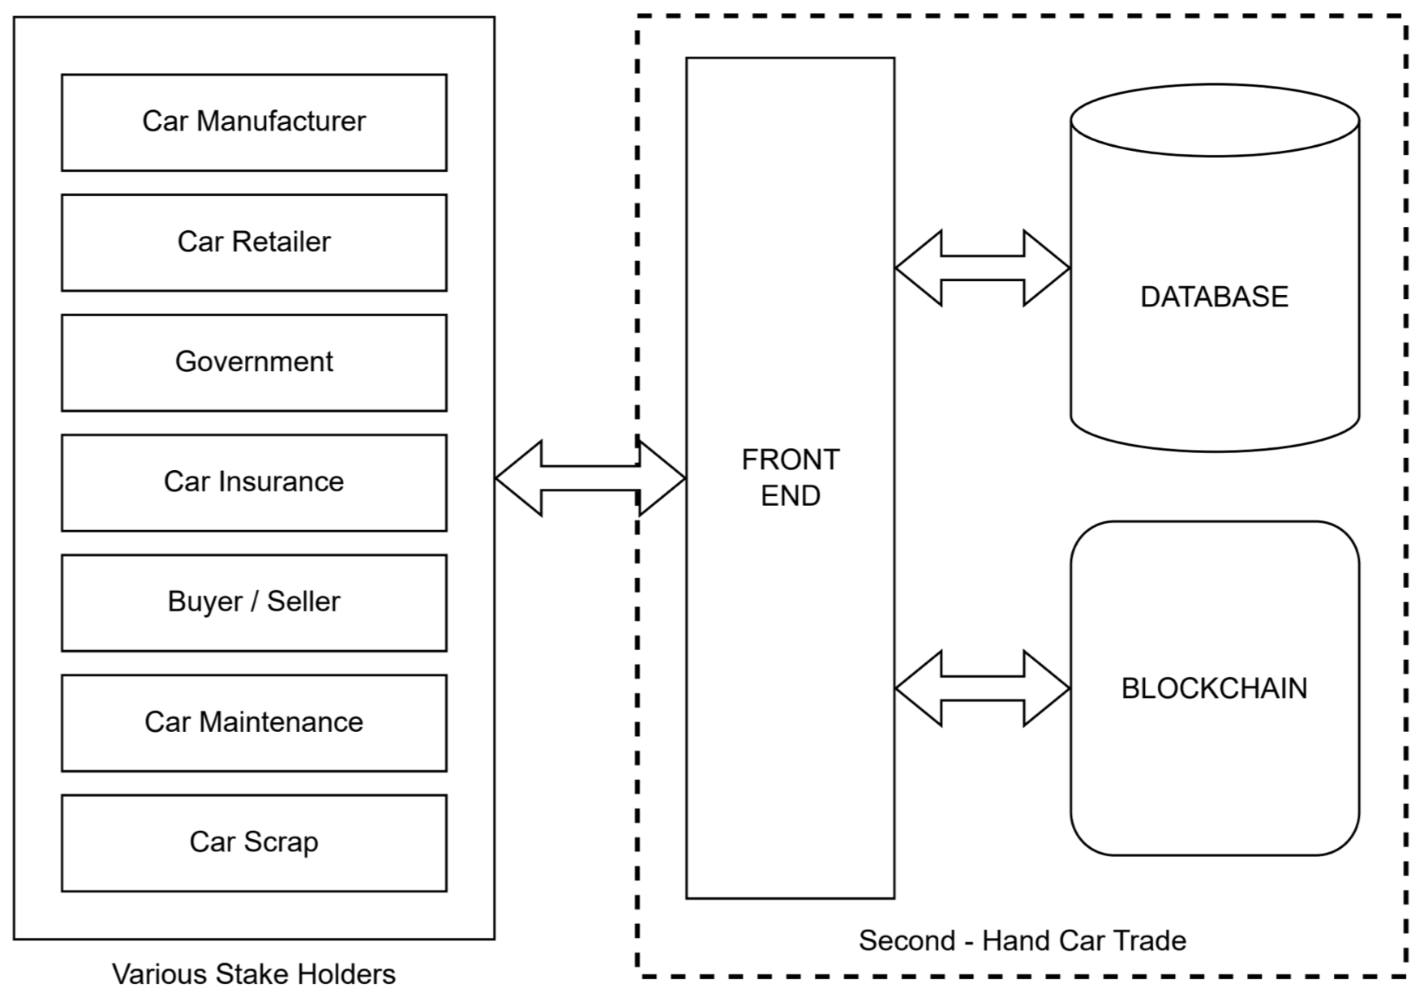
System Design - Top-level Design
Top-level design
  Front-end
    Html
    CSS
    AngularJS
  Backend - Server
    NodeJS
    ExpressJS
    MongoDB
  Backend - Blockchain
    Hyperledger fabric
    Docker
    Smart contracts - GO

Slide 6
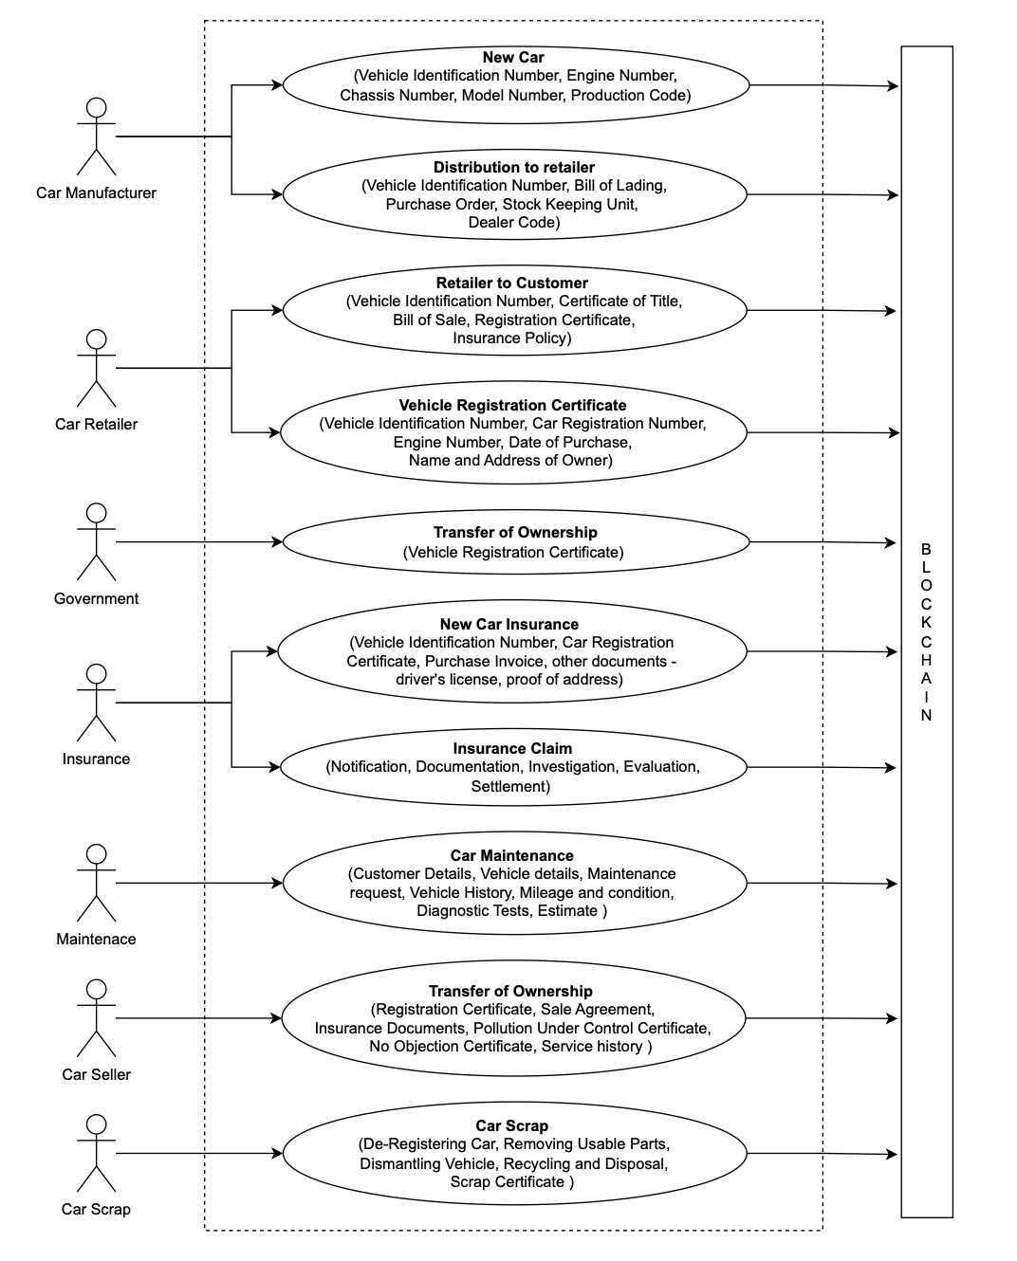
System Design - Use Case Diagram
Notes:
https://drive.google.com/file/d/1xV9TocRGyj72LvN5jco7XN7z4AwS-B_C/view?usp=share_link

Slide 7
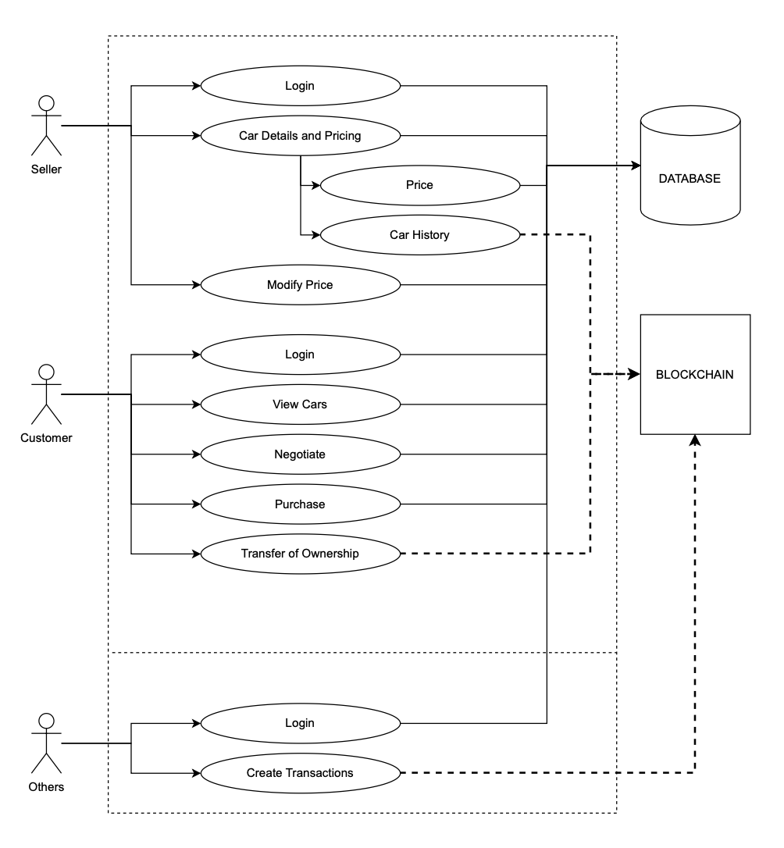
System Design - Front-end - Use Case
Notes:
https://drive.google.com/file/d/1xHXmgeqKBqesKdHNN6KnDNzCBV7kHKZr/view?usp=share_link

Slide 8
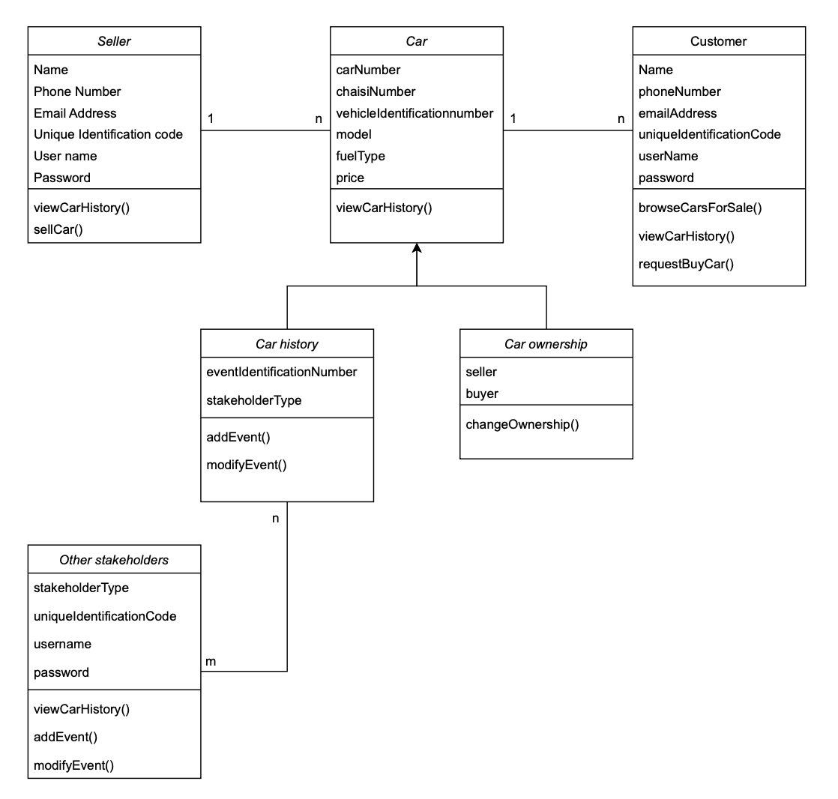
System Design - Class Diagram
Notes:
https://drive.google.com/file/d/1JG_6vk5xWjbX-fBBlpejwbS3BbrXq-mM/view?usp=share_link

Slide 9
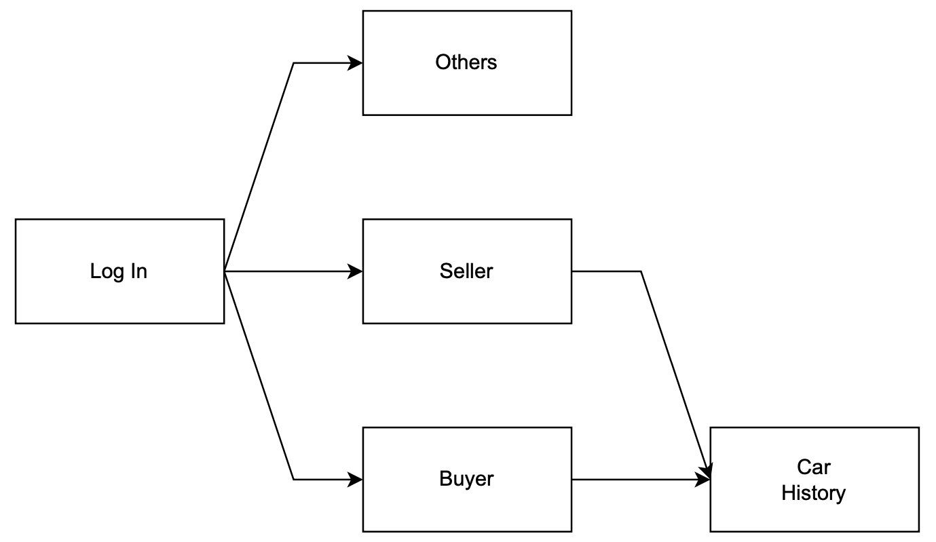
System Design - Front-end - Wireframe

Slide 10
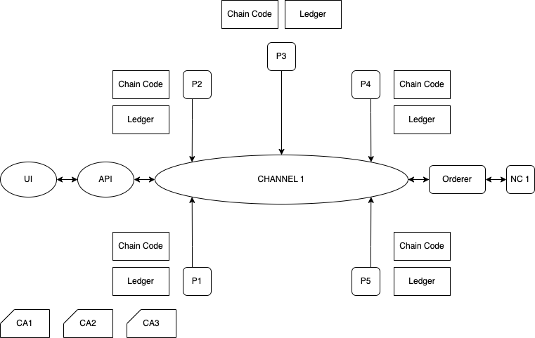
System Design - Blockchain Architecture
Distributer
Retailer
Seller
Network
Configuration
Manufacturer
Buyer
Certificate Authority

Slide 11
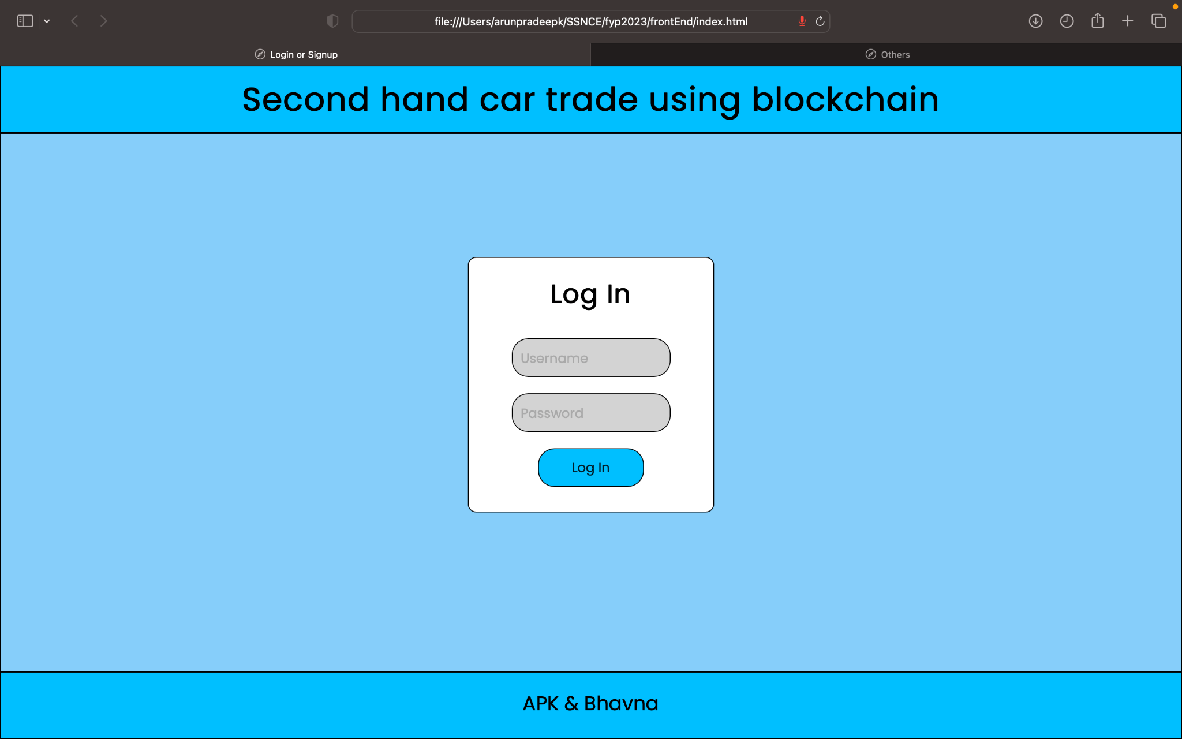
Implementation with results
Login page (screenshot)

Slide 12
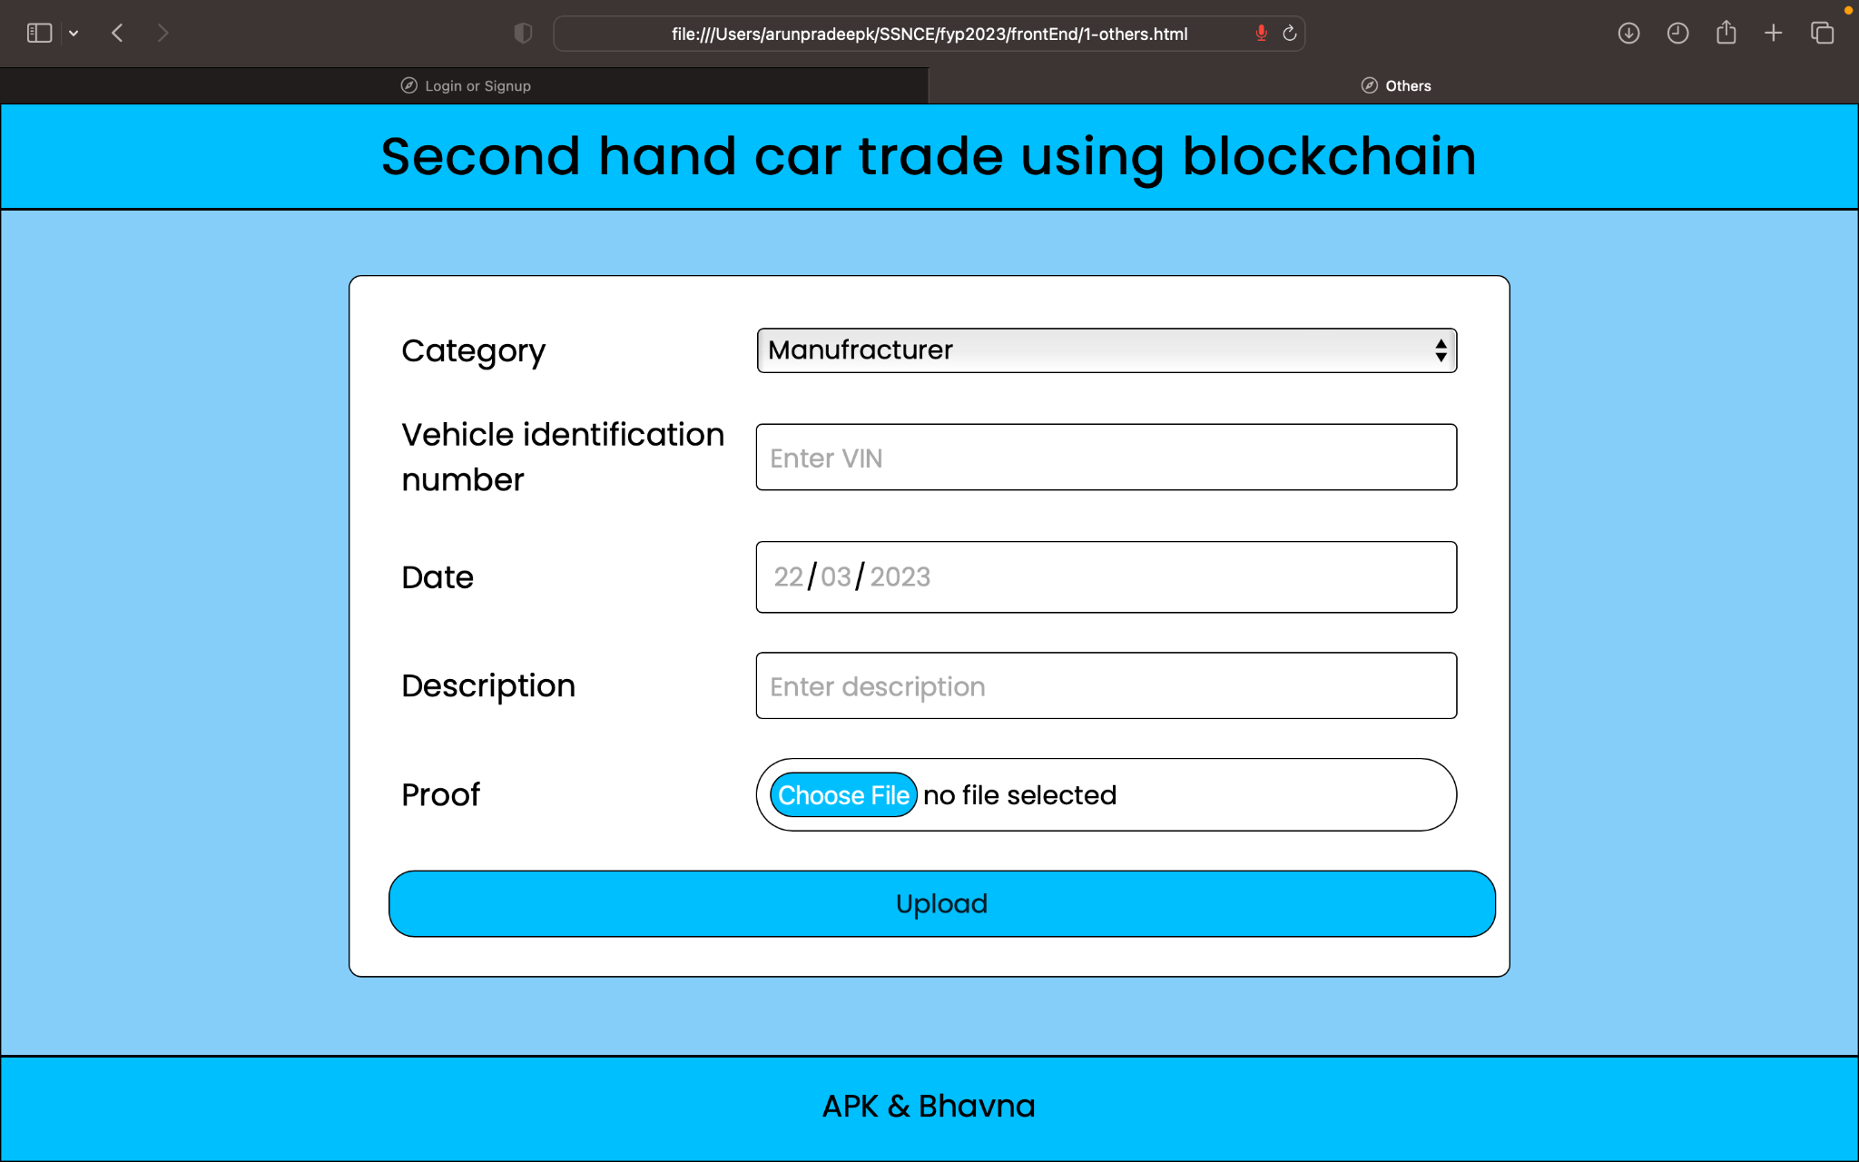
Implementation with results
Others page (screenshot)

Slide 13
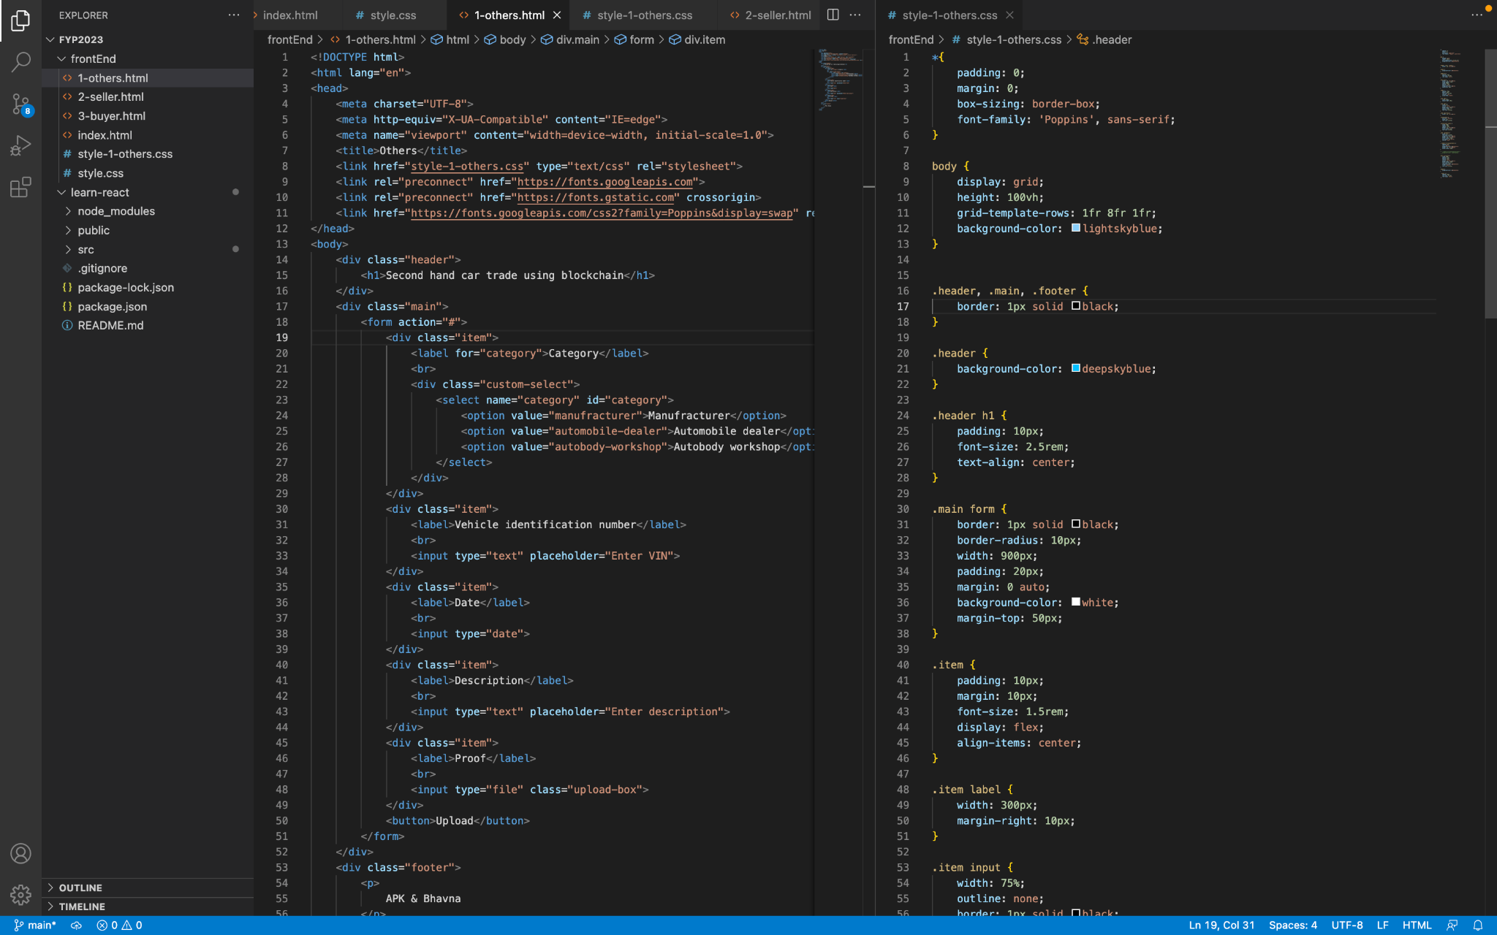
Implementation with results
Others page (sample code)

Slide 14
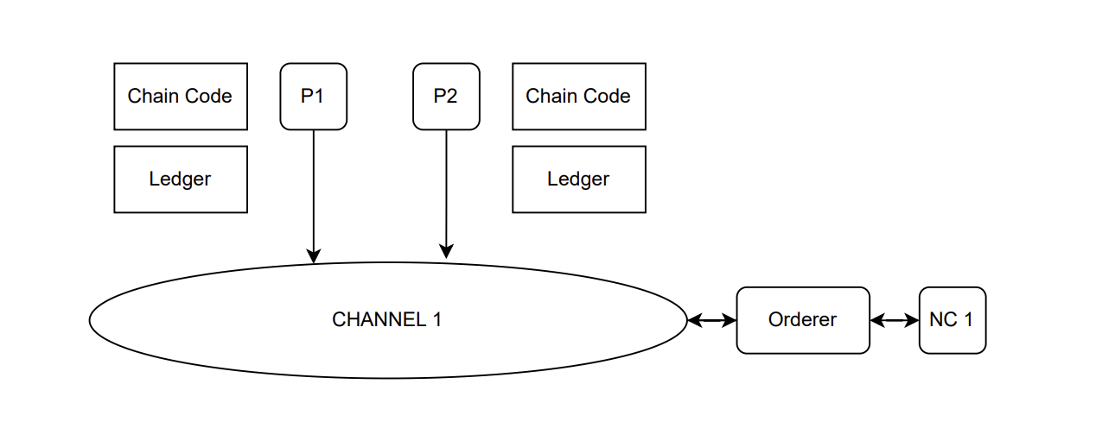
Implementation of Blockchain

Slide 15
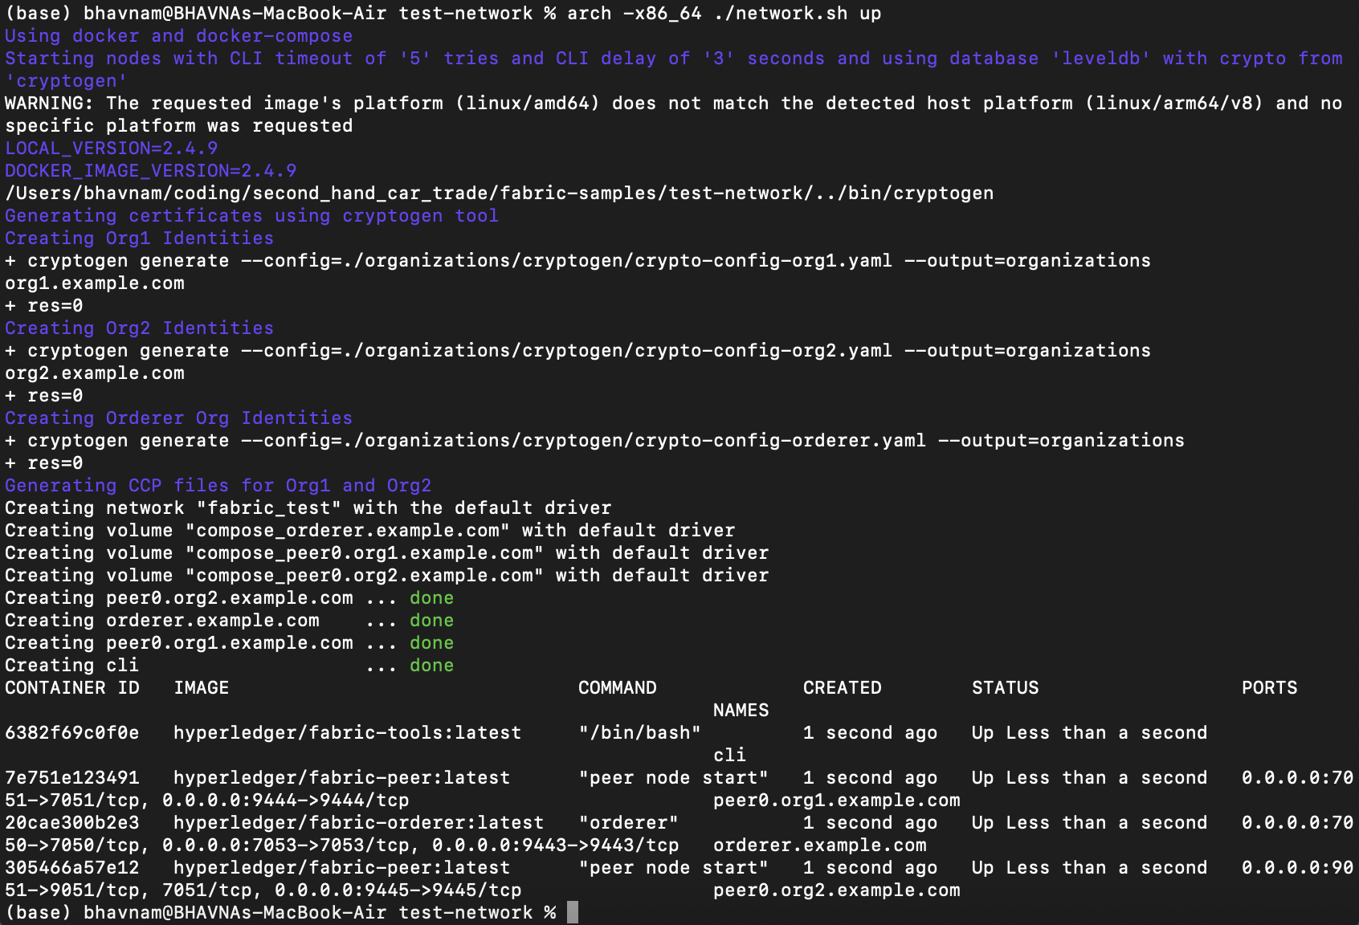
Implementation of Blockchain - Network Creation

Slide 16
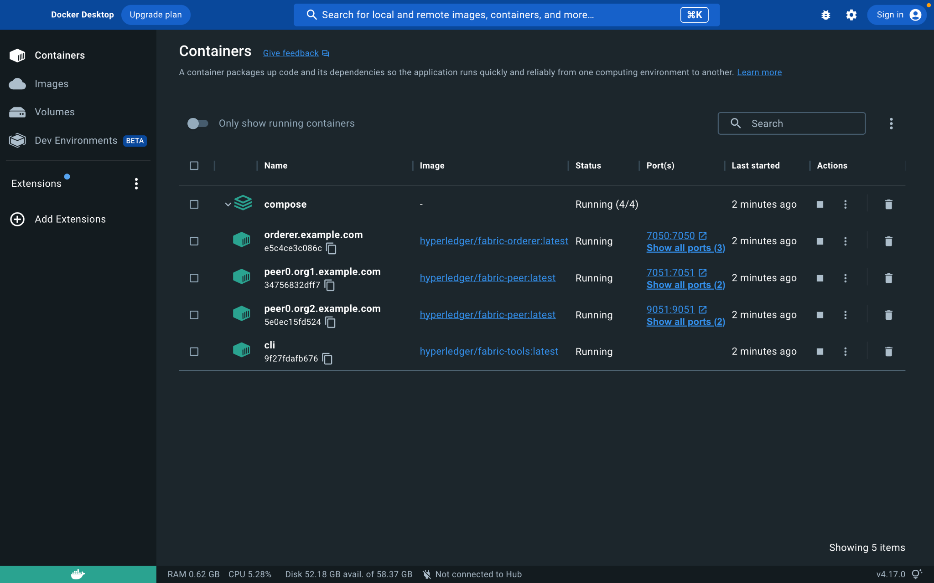
Implementation of Blockchain - Docker Images

Slide 17
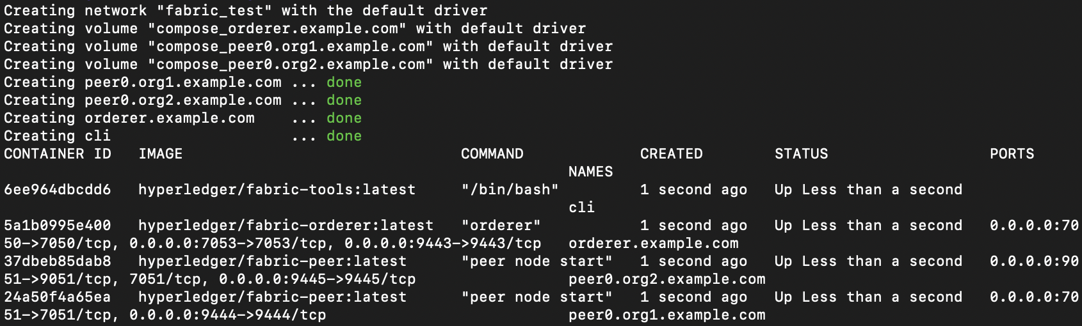
Implementation of Blockchain - Creating Network

Slide 18
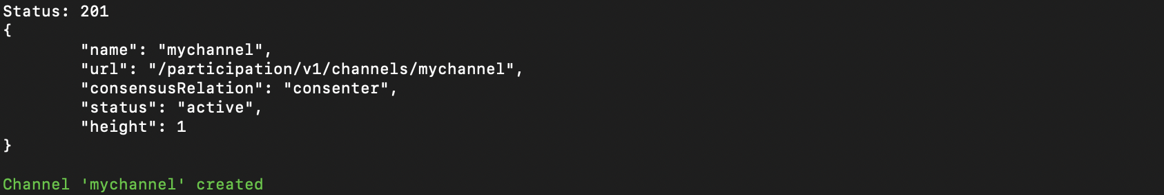
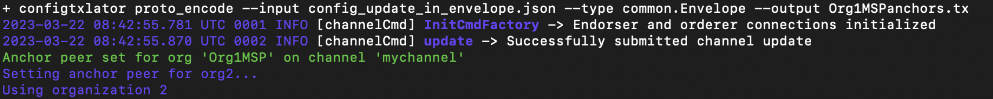
Implementation of Blockchain - Creating Channel

Slide 19
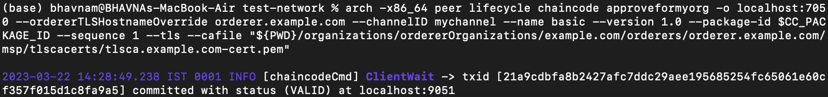
Implementation of Blockchain - Installing chaincode

Slide 20
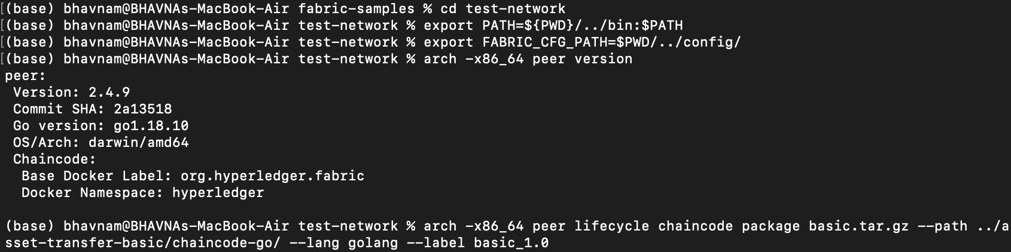
Implementation of Blockchain - Creating Chaincode package

Slide 21
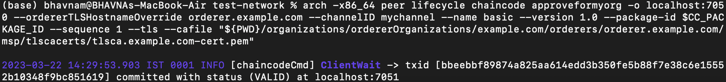
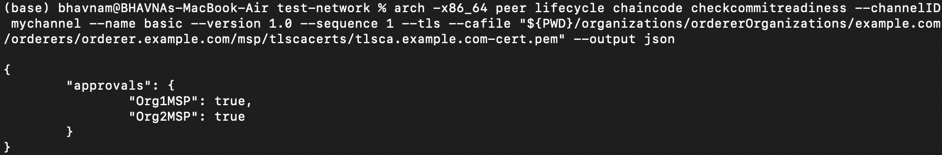
Implementation of Blockchain - Chaincode Approval

Slide 22
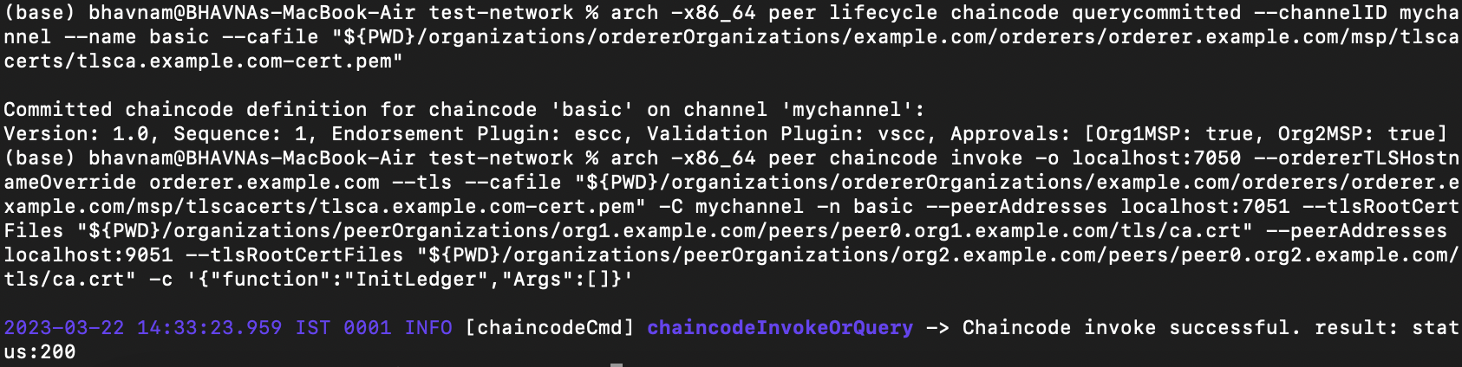
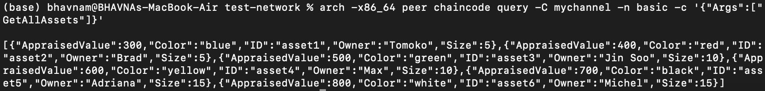
Implementation of Blockchain - Invoking Chaincode

Slide 23
Cost
Tech stack used:
Front-end
  HTML, CSS, AngularJS
Back-end - Server
  NodeJS, ExpressJS
  MongoDB
Back-end - Blockchain
  Hyperledger fabric
    Git
    cURL
    Docker
    GO
    jk
Cost associated: None. (All the softwares and technology used are open source)

Slide 24
Future work
Front-end
  Create 3 webpages - seller, buyer & car history
Back-end - Server
  Route all the webpages
  Connect to database
Back-end - Blockchain
  Develope full network
  Deploy smart contracts
Integration

Slide 25
THANK YOU!

